Slide 1
Series and parallel connection - Inductor

Slide 2
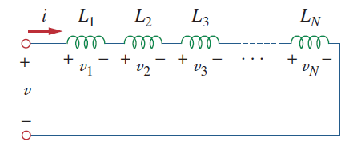
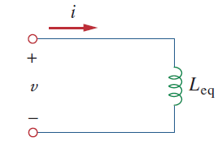
Series connection
A single path for the current to flow which is equal
Voltage across the components will be different

Slide 3
Series connection

Slide 4
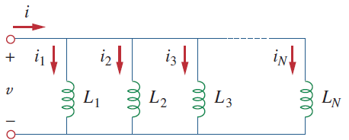
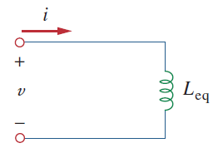
Parallel connection
Multiple path for the current to flow which is different
Voltage across the components will be equal

Slide 6
Reference
Edward Hughes. “Electrical and Electronic Technology”, 10th Edition, Pearson Education Asia, 2019
Alexander and Sadiku. “Fundamental of electric circuits”, McGraw-Hill, Fifth editon

Slide 7
Thank You

